Slide 1
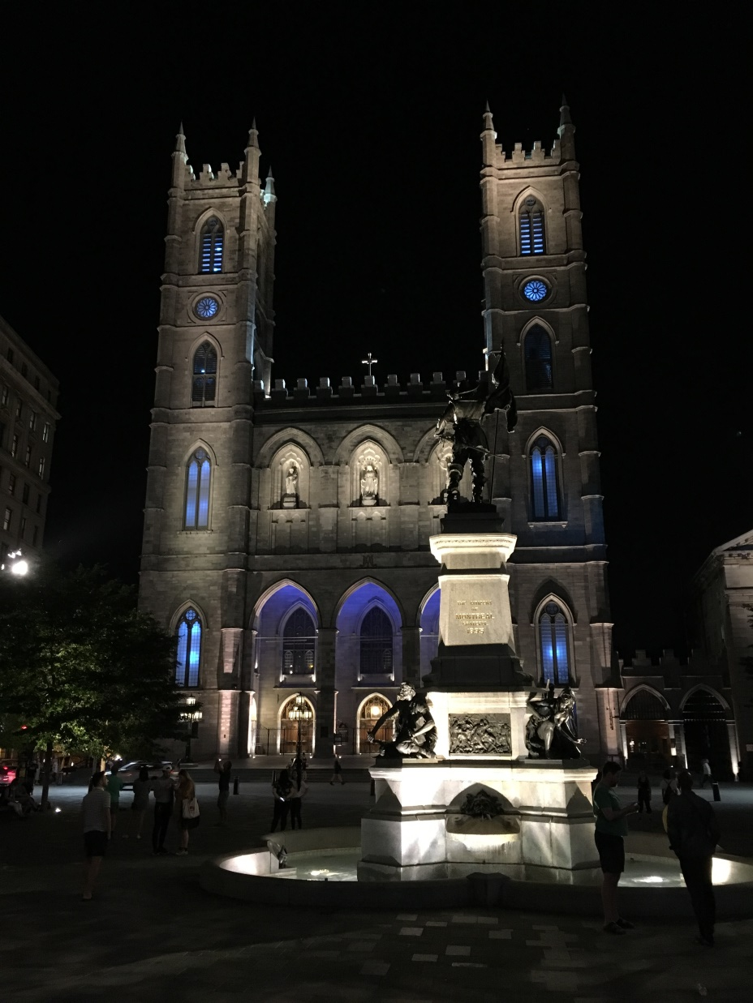
IETF Hackathon:
Software Updates for IoT (SUIT)
IETF 102
14-15 July, 2018
Montreal

Slide 2
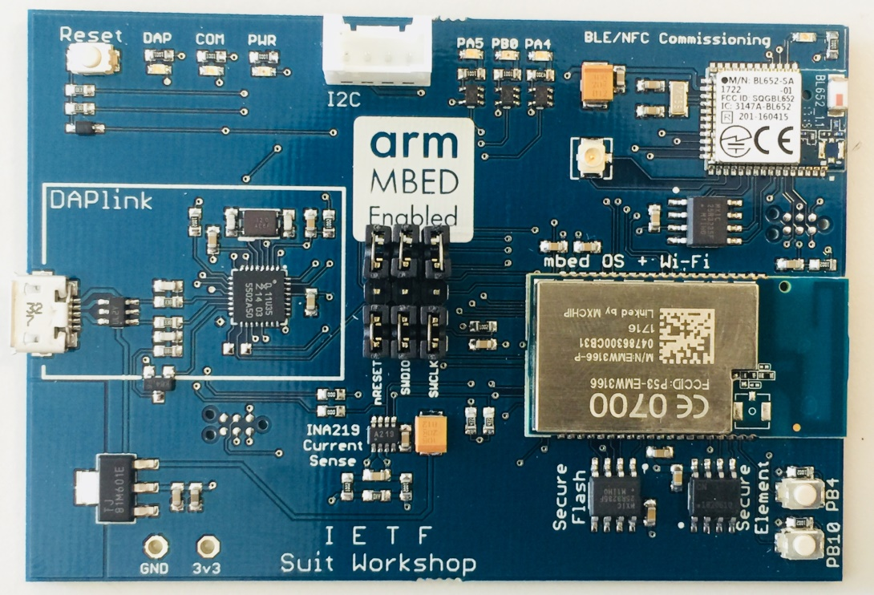
Hackathon Plan Software Updates for IoT
Generate a manifest
Encode it in CBOR
Sign it with COSE
Verify it on a SUIT prototyping board.

Slide 3
The Group
Team:
Hannes Tschofenig
Jaime Jiménez
Felipe Espinoza
Alexandra Ibarra
Thomas Fossatti
Bill Silverajan
David Waltermire
Laurence Lundblade
1st time IETF
1st time SUIT Hackathon

Slide 4
What got done
Set up development environment for use with new board on multiple OSs. Mbed OS was used as an IoT operating system.
Generate the manifest
Encode it
Sign it
Verify it on the device
Detailed write-up available at https://git.io/fNYC6

Slide 5
What we learned
Making setup for 1st time users easier would be good. A preconfigured environment would be good.
We need to use IDEs for debugging (e.g., Keil uVision 5) → example project or software packs
New development board works but we bricked 3 boards (potential issue on Macs).
Getting to a small codesize for the bootloader will be difficult with CBOR and COSE.
Parsing of CBOR encoded manifest is not straightforward.
Manifest could use map instead of array for simpler parsing.

